Slide 1
Title
The Compact Line
Networked Metering and Control

Slide 2
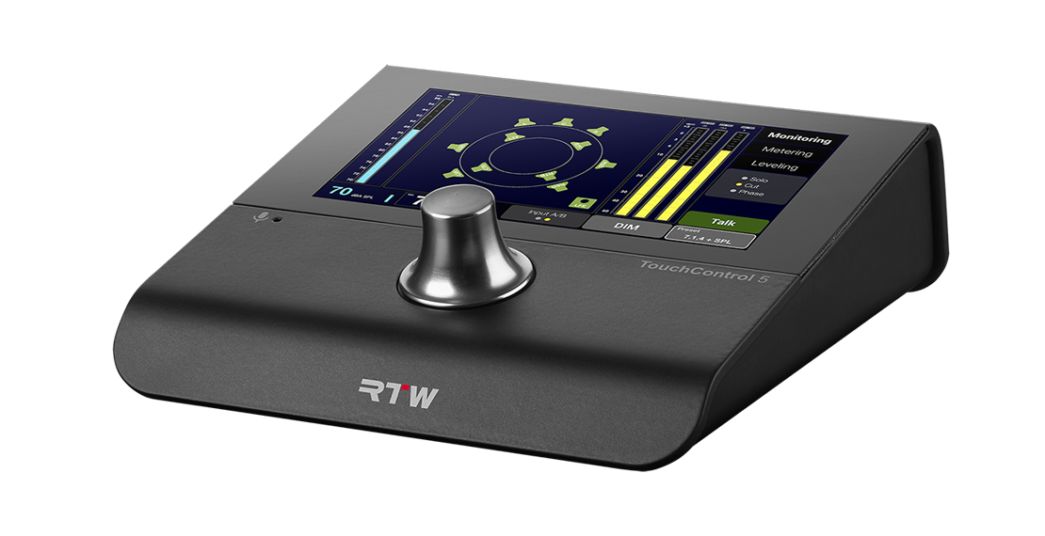
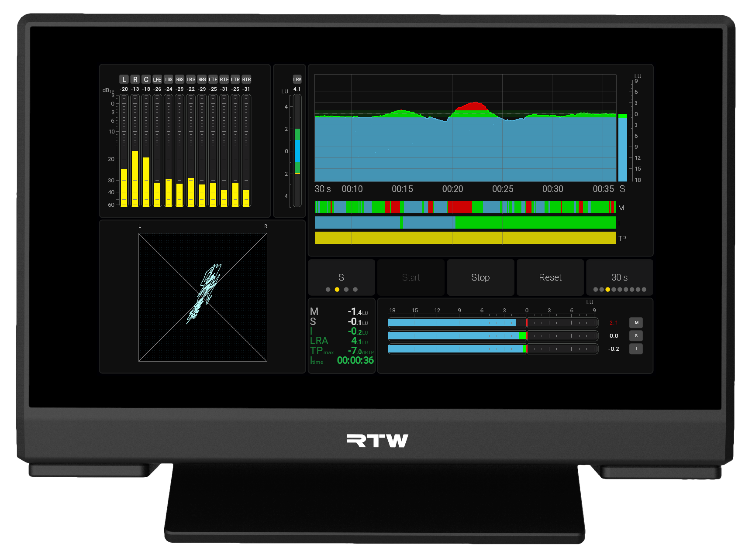
Networked Metering and Control
TouchControl 5
TouchMonitor 5

Slide 3
Compact Line
Background
What is it?
Audio Network: Dante® or Ravenna® versions
  AES67 / ST2110, NMOS
Truly Immersive with support for ultrachannel formats such as Dolby Atmos
Monitor Control, Metering, Tools
Come fully loaded with RTW’s trusted, loudness-compliant metering
Networked setup and control while fully operational in stand-alone mode

Slide 4
Compact Line
Background
Who is it for?
Broadcast (5.1 surround)
  Live production
  Ingest
  Post Production
Producers & Studio Engineers (7.1.4 Immersive)
Facilities with Network-based Infrastructure
Radio

Slide 5
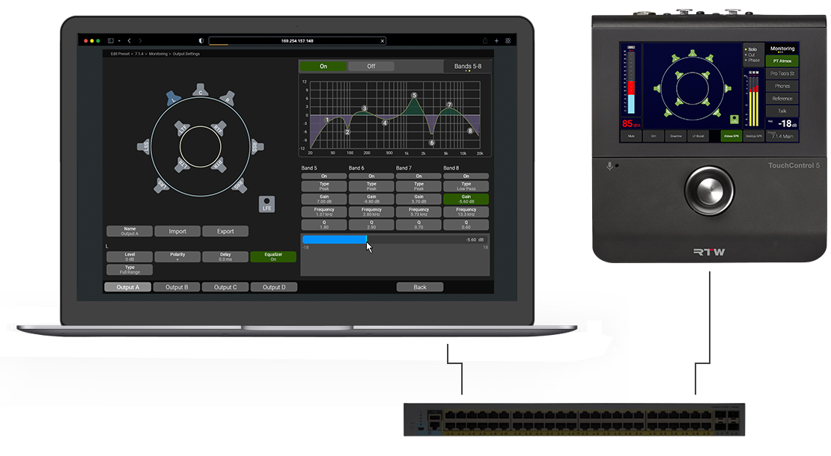
Compact Line
Features
Web Browser Control

Slide 6
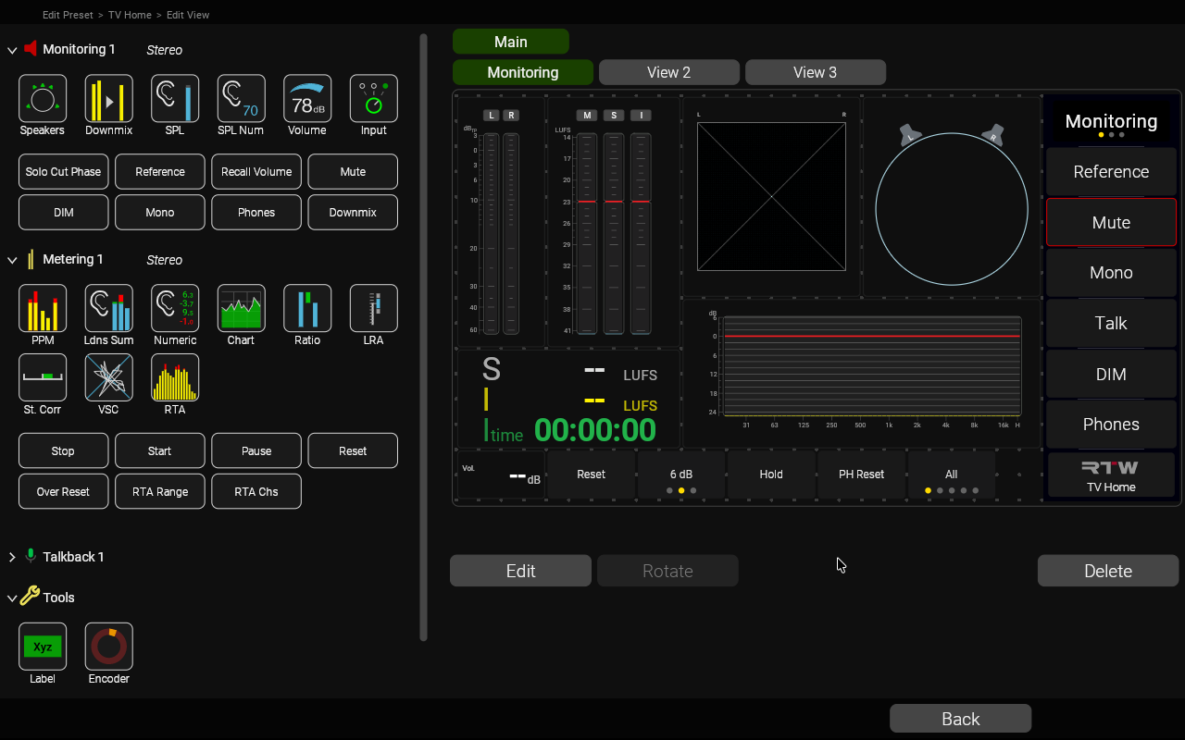
Compact Line
Features
Customize Your View
Placement
Size
Rotation
Multiple views

Slide 7
Compact Line
Features
Simple

Slide 8
Compact Line
Features
Atmos

Slide 9
Compact Line
Features
Metering

Slide 10
Compact Line
Features
Combination

Slide 11
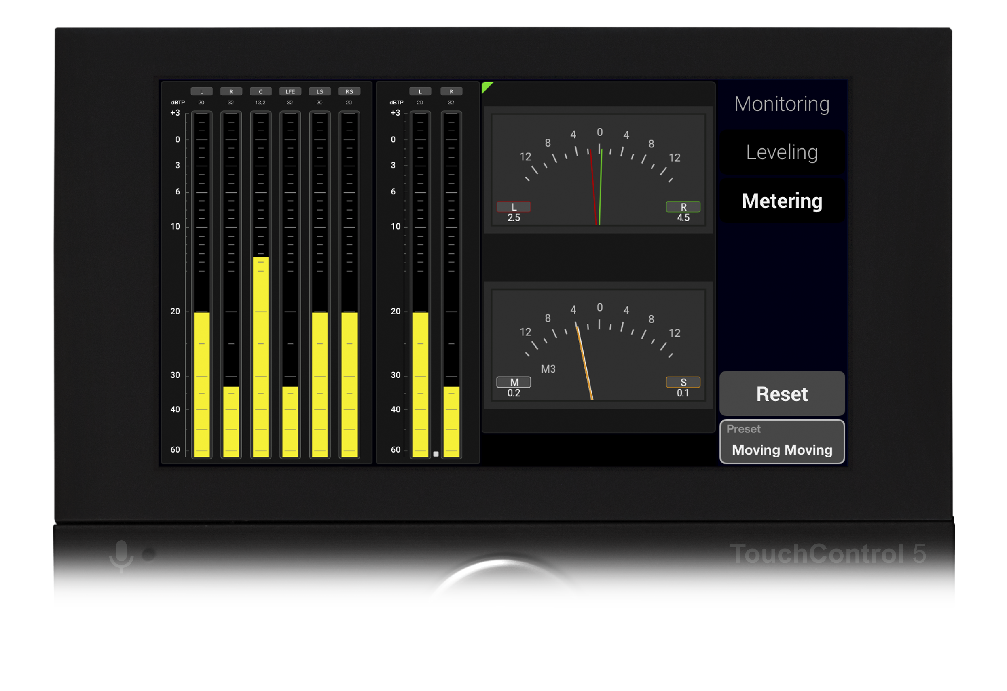
Compact Line
Features
RTW Metering Inside
RTW Metering, known from the TouchMonitor Series
Always Reliable. Always Flexible. Always Compliant

Slide 12
Compact Line
Features
Loudness
Full implementations of the latest loudness standards and recommendations: EBU R128, ITU-R BS.1770-4/1771-1, ATSC A/85, ARIB, OP-59, AGCOM, CALM, LEQ(M), TASA, SAWA
Bargraphs for summed Loudness with Momentary, Shortterm, Integrated values
Numerical display of all relevant values like M, S, I, LRA, TPmax, Mmax, Smax, Itime
LRA Instrument

Slide 13
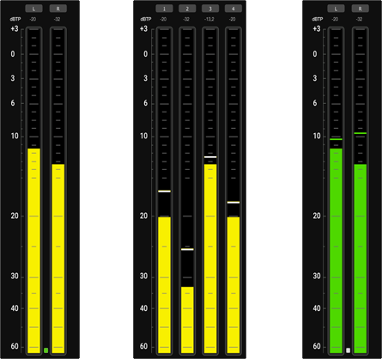
Compact Line
Features
PPM
Any feature that any broadcaster has ever asked for in the history of metering :-)
Scale Marker
Operation Range
DC filter
Spot Correlator
Integration Time
Custom Colors

Slide 14
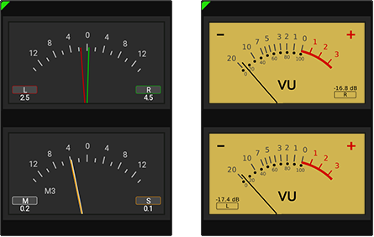
Compact Line
Features
More…
Moving Coil / British VU

Slide 15
Compact Line
Features
More…
Moving Coil / British VU
VectorScope

Slide 16
Compact Line
Features
More…
Moving Coil / British VU
VectorScope
Loudness Chart

Slide 17
Compact Line
Features
More…
Moving Coil / British VU
VectorScope
Loudness Chart
Realtime Analyzer

Slide 18
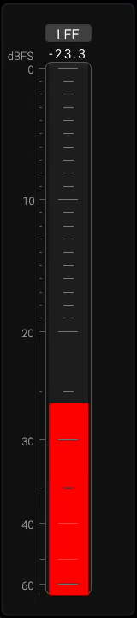
Compact Line
NEW
Features
New: LFE Bleed
Avoid high frequency content in your LFE Channel
    Monitors energy above a defined threshold (120 Hz by default) with a compact dBFS bargraph, highlighting any leakage into the LFE channel(s).
    Recommends limiting the LFE frequency range to maintain compatibility and avoid distribution problems.
    Ensures that unwanted high-frequency content is not present in the LFE channel(s), preventing playback issues across encoders and binaural formats.

Slide 19
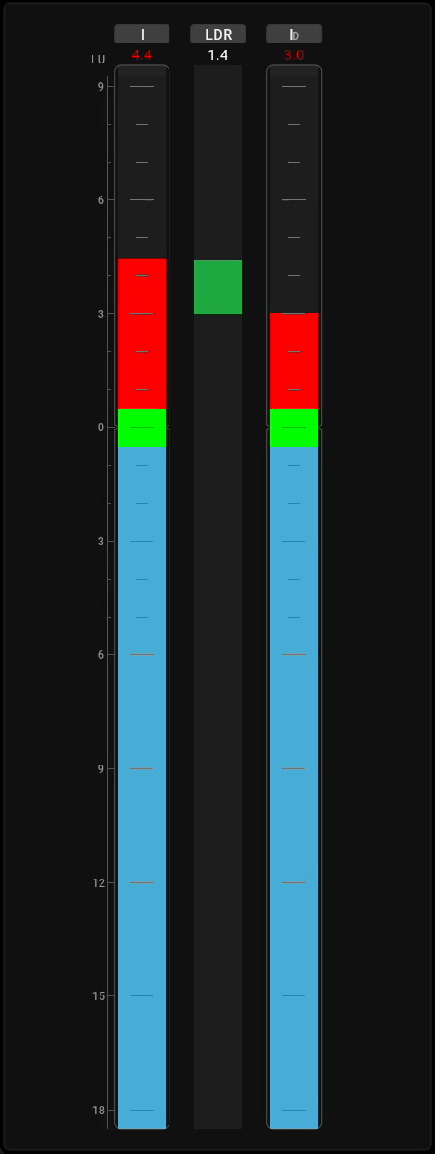
Compact Line
NEW
Features
New: The Ratio Instrument
Keep an Eye on the Dialogue Ratio
    Displays the ratio between two measurements, enabling precise evaluation of ratio and consistency.
    Supports key use cases such as Loudness-to-Dialog Ratio (LDR) and Background-to-Dialog Ratio (BDR) within a single source.
    Compares loudness across different sources or renderings (e.g., pre/post processing, immersive vs stereo), revealing the impact of processing and format changes

Slide 20
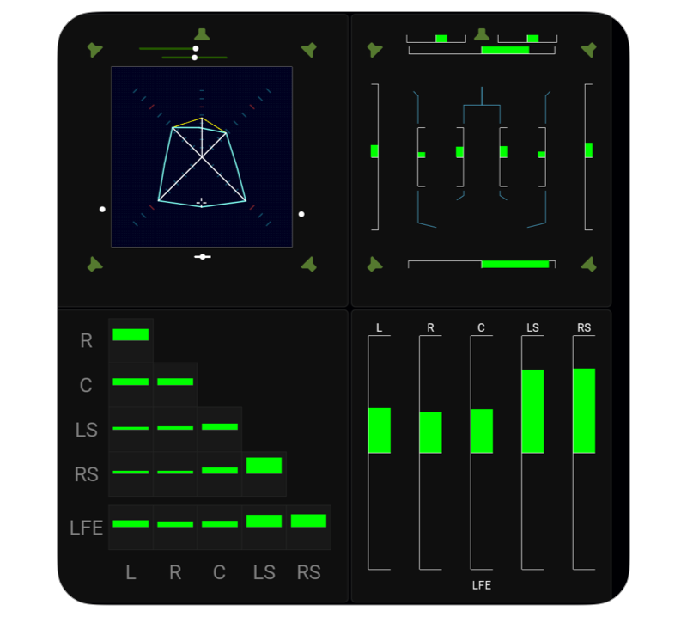
NEW
Features
Surround & Immersive Instruments
Immersive Sound Analyzer
MatrixCorrelator
MultiCorrelator

Slide 21

NEW
Features
External Logging & Integration
LAWO HOME Integration
Prometheus & Grafana Monitoring
Genelec Smart IP Speaker Control
NMOS IS-07 Event Support

Slide 22
Features
Action Instrument & OSC
Support for Open Sound Control
    Create customizable buttons with user-defined size, position, and color.
    Trigger actions via Open Sound Control (OSC over TCP/UDP) or HTTP.
    Two-way OSC: TMxCore also reacts to incoming commands such as preset recall, loudness control, reference level, and mic gain.
    Actions is integrated in current buttons (Mute, Dim, etc.), too

Slide 23
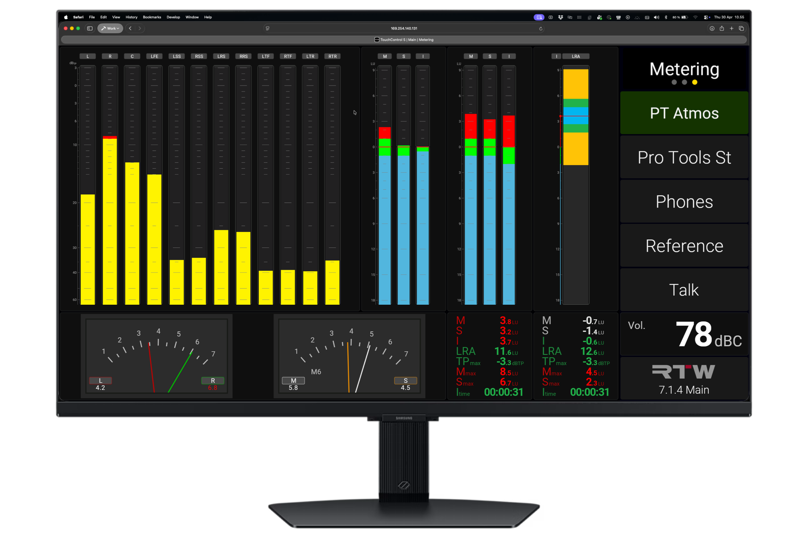

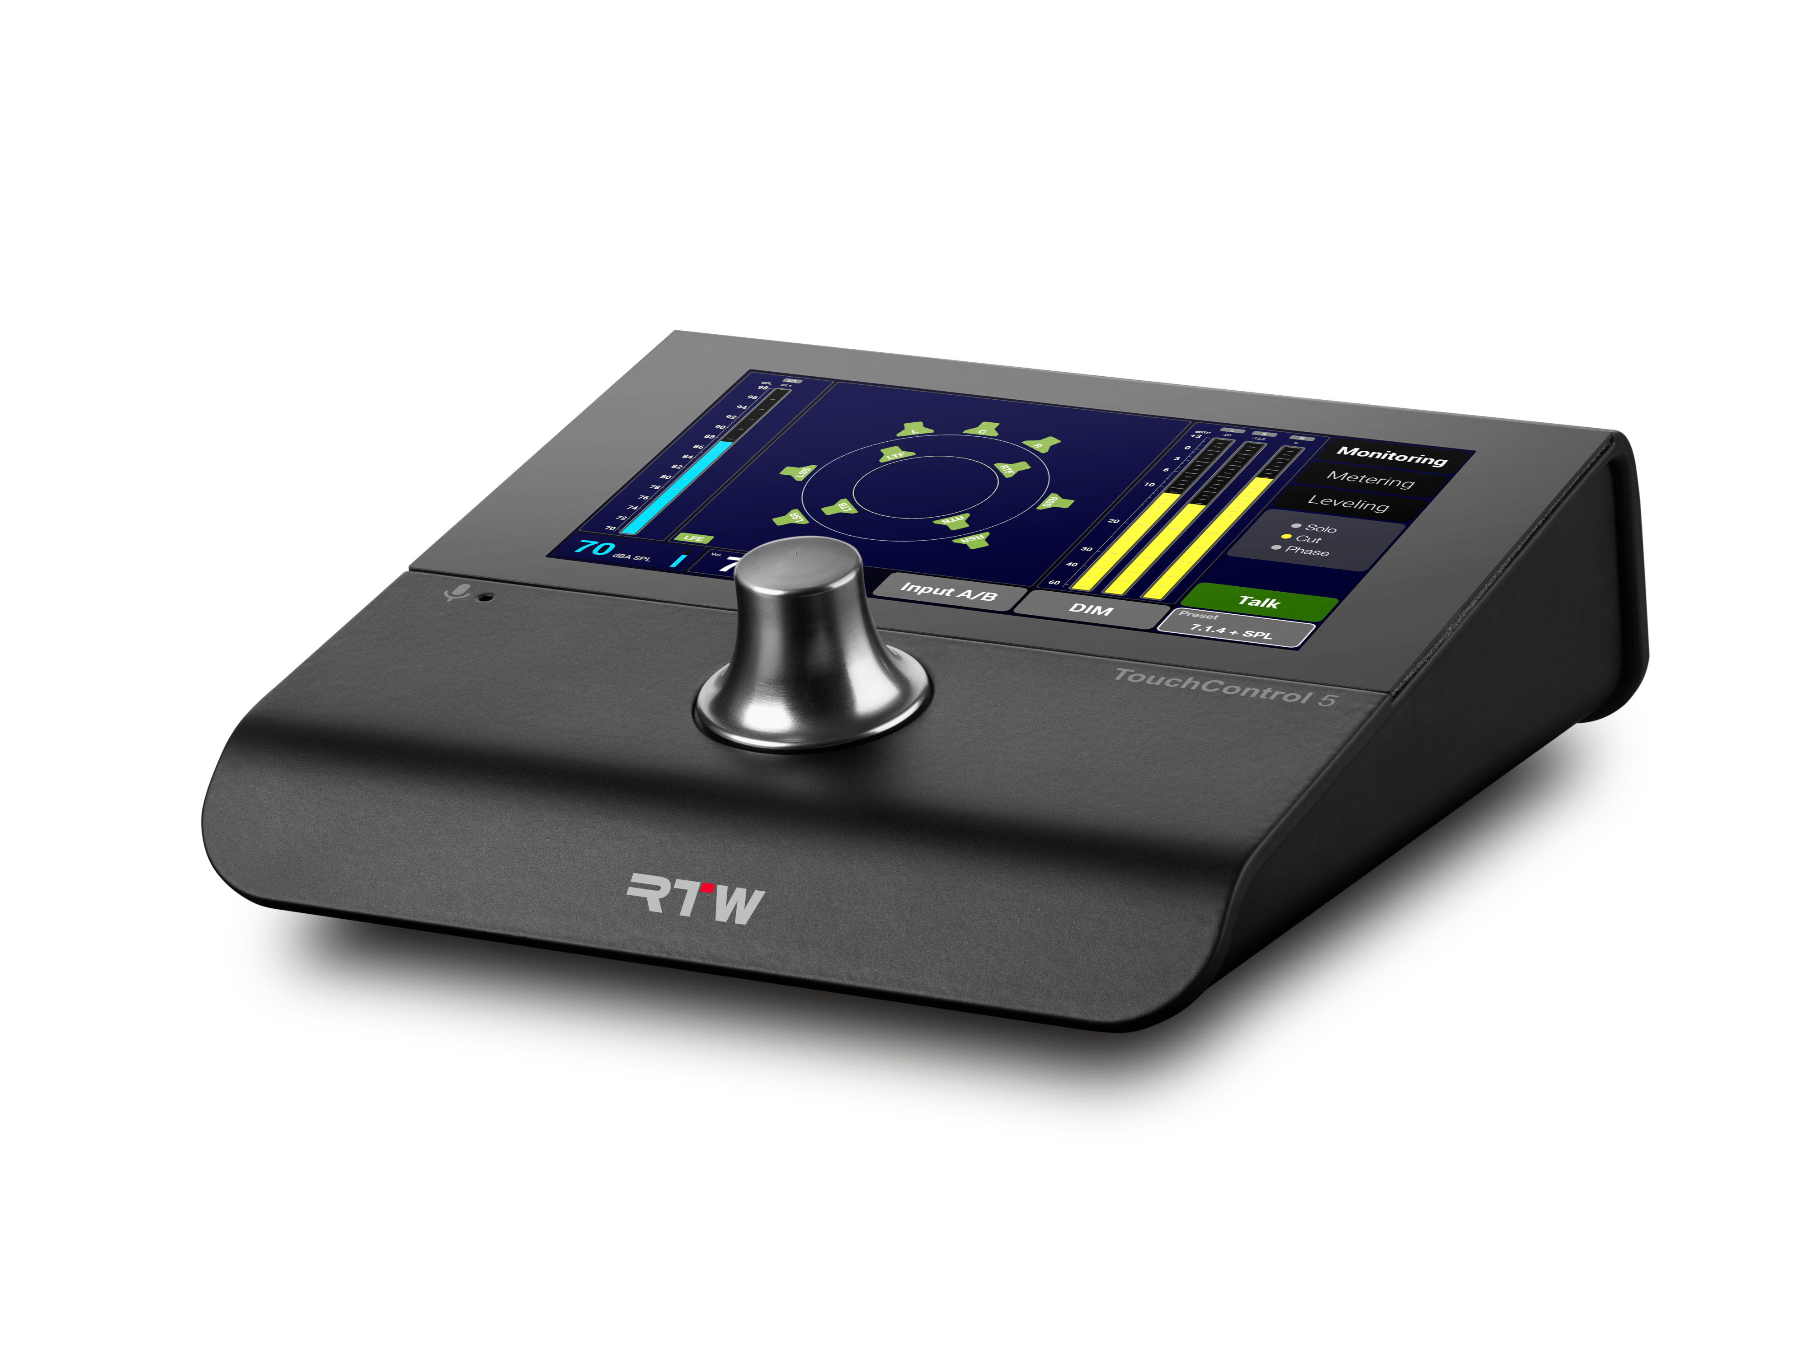
Network Display
Eyes on your Audio from Everywhere

Slide 24
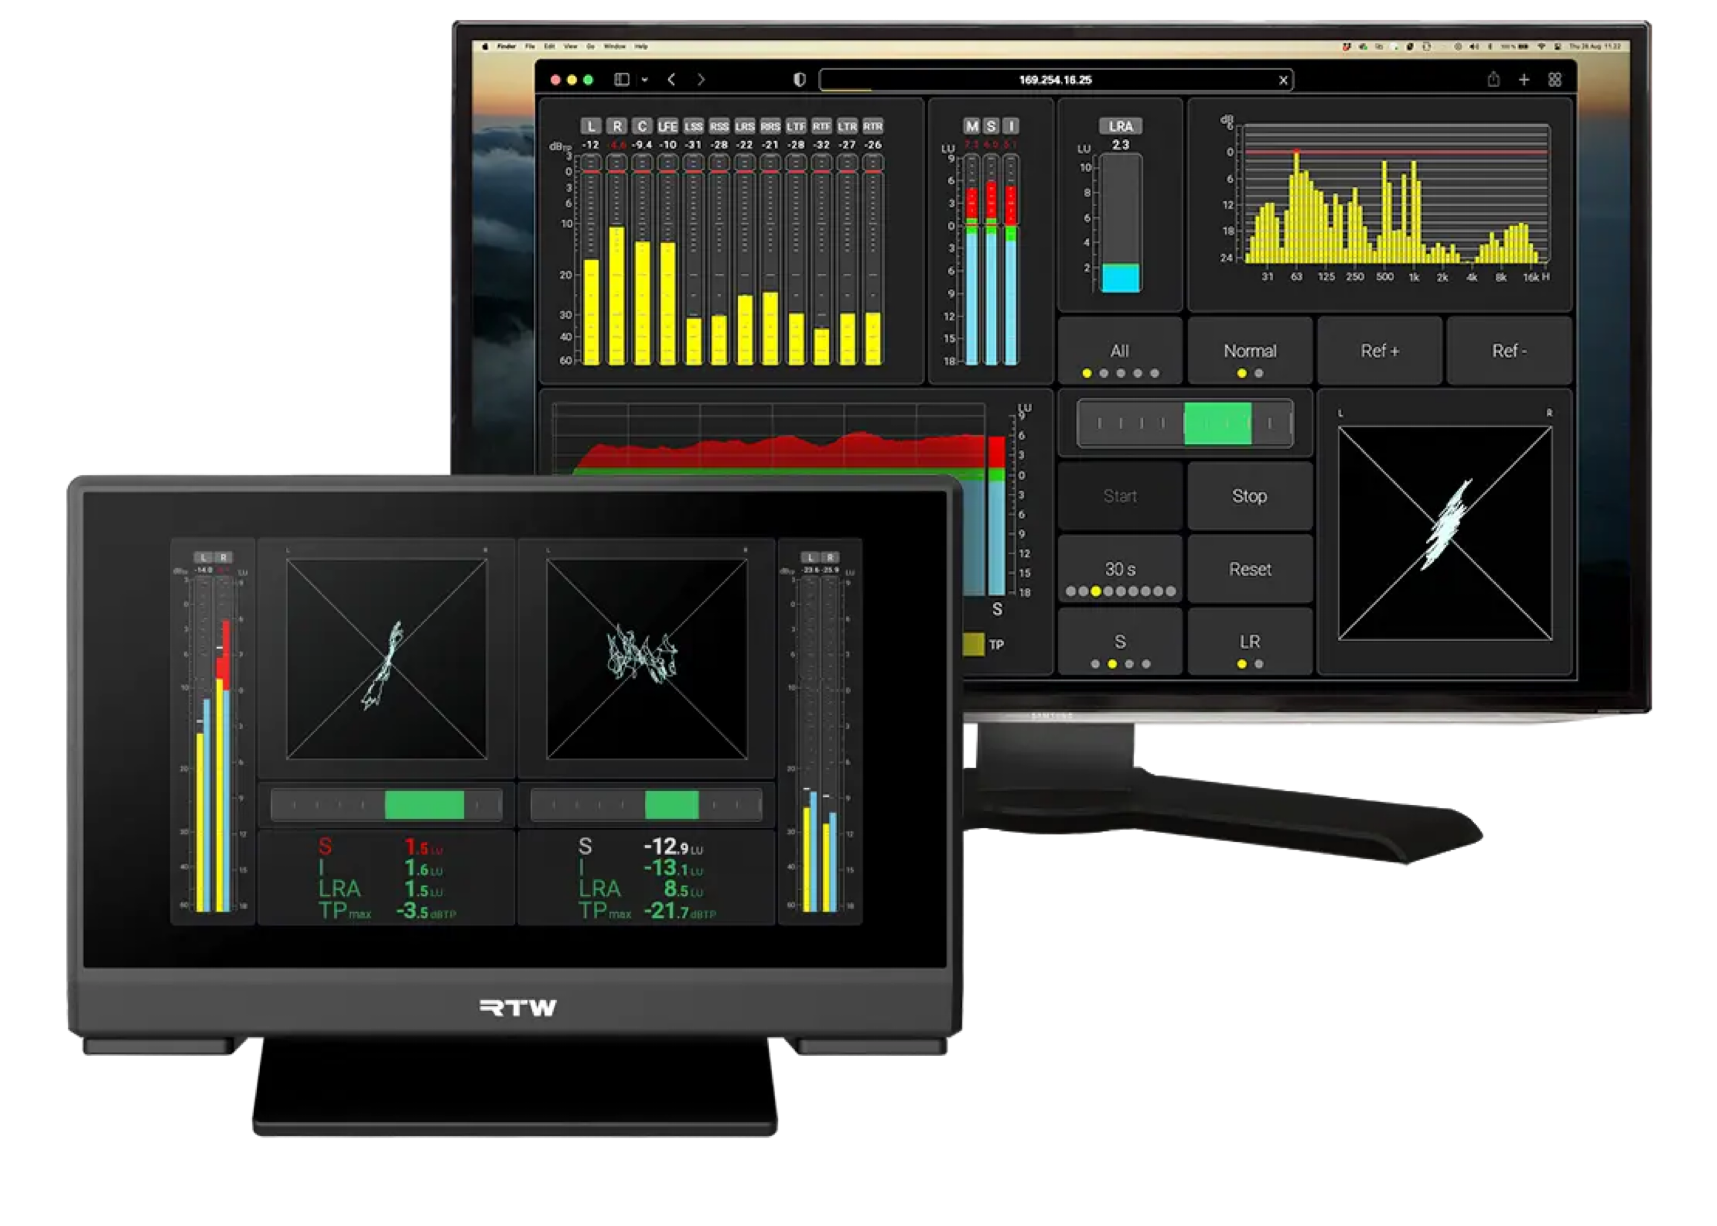
Network Display
Eyes on your Audio from Everywhere
Add an extra screen to your device
Any browser, anywhere
Show a different view than the device screen

Slide 25
Title
  TouchControl 5
Metering meets Monitor Control

Slide 26
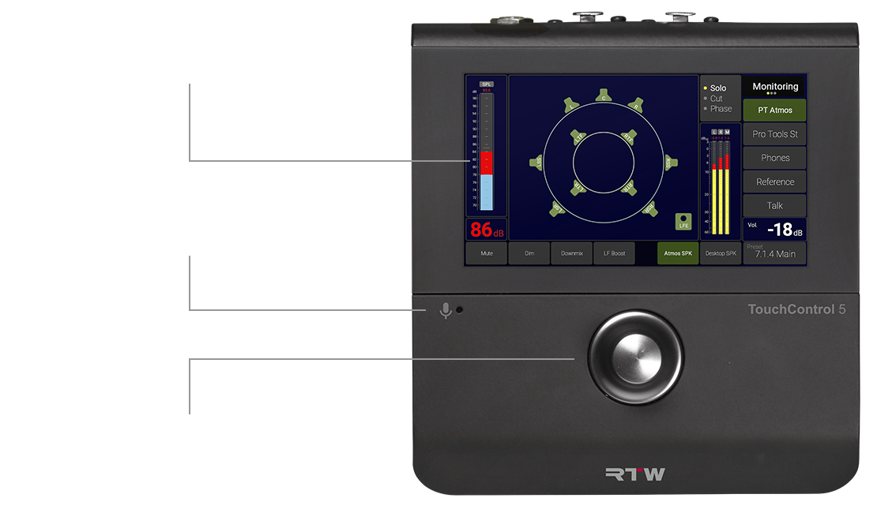
User Configurable 5” Touch Display

Slide 27
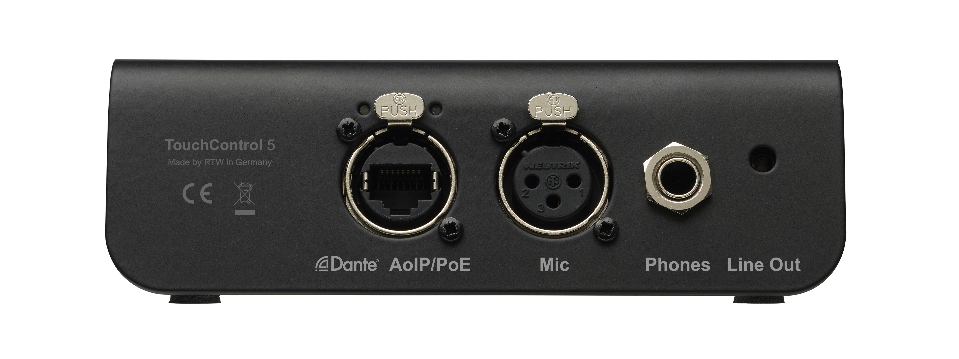
Features
Rear
Studio Grade Microphone Input with 48v
Analog Line Outs for External Speakers
Audio over IP
Power over Ethernet
Studio Quality Headphone Outputs

Slide 28
TouchControl 5
Title
Ultra Channel
From stereo, over surround to immersive

Slide 29
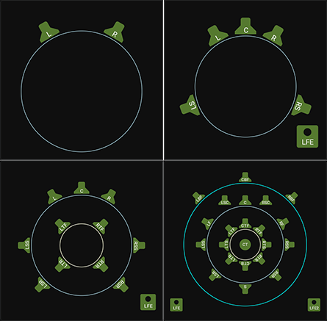

Slide 30
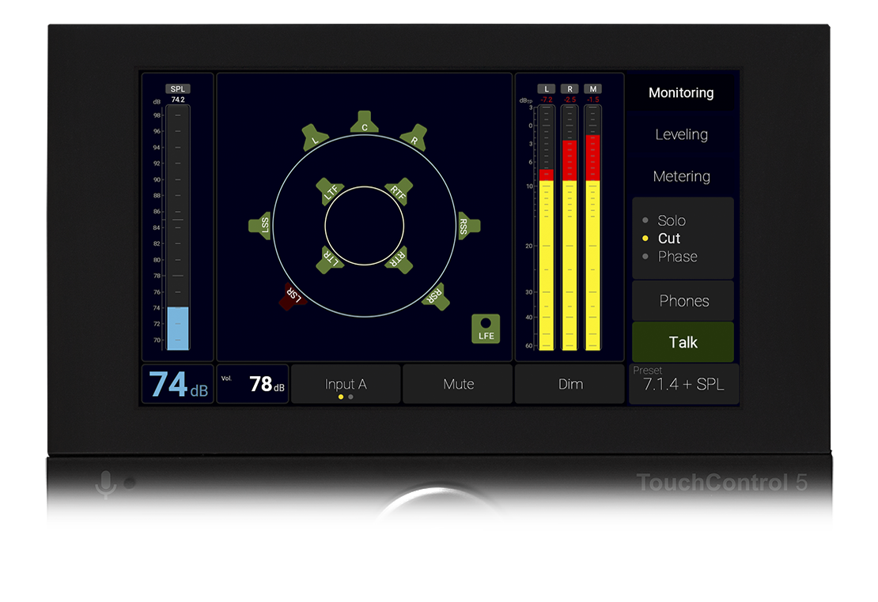

Slide 31
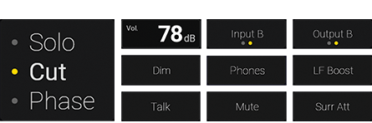
TouchControl 5
Features
Monitor Control
Solo, Cut, Phase
Mono, Dim, Mute
Phones, Talk
Low Frequency Boost (+10dB)
Surround Attenuation (-3dB)
Input and Output Selector
Notes:
Live Demo

Slide 32
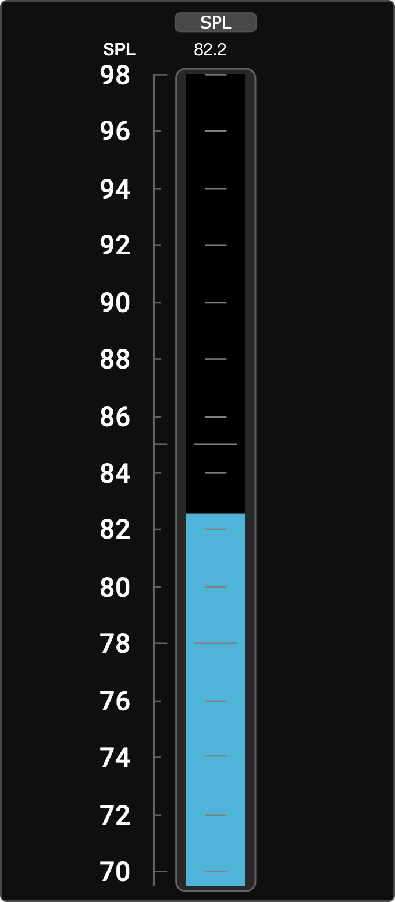
TouchControl 5
Features
SPL Measurement
SPL Readout
Based on MIC, XLR or Measurement

Slide 33
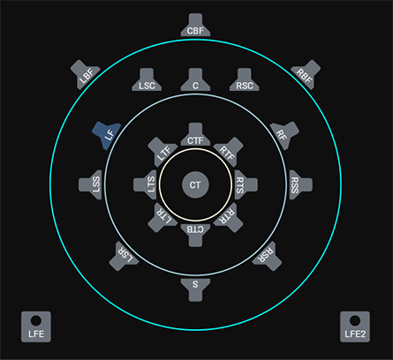
TouchControl 5
Features
Bass Management
Variable Frequency and Send Level Per Speaker
Overall Sub Level
Support for Dual Bass Management SUBs
Phase Safe Mode

Slide 34
TouchControl 5
Features
Calibration
Level, Polarity, Delay
Tone Generator
SPL Measurement

Slide 35
TouchControl 5
Features
EQ
8 Band EQ
  Peak, Low Shelf, High Shelf, Low Pass, BandPass, High Pass, All Pass 2nd Order, All Pass 4th Order, Notch
Per Speaker
Dolby Music Curve

Slide 36
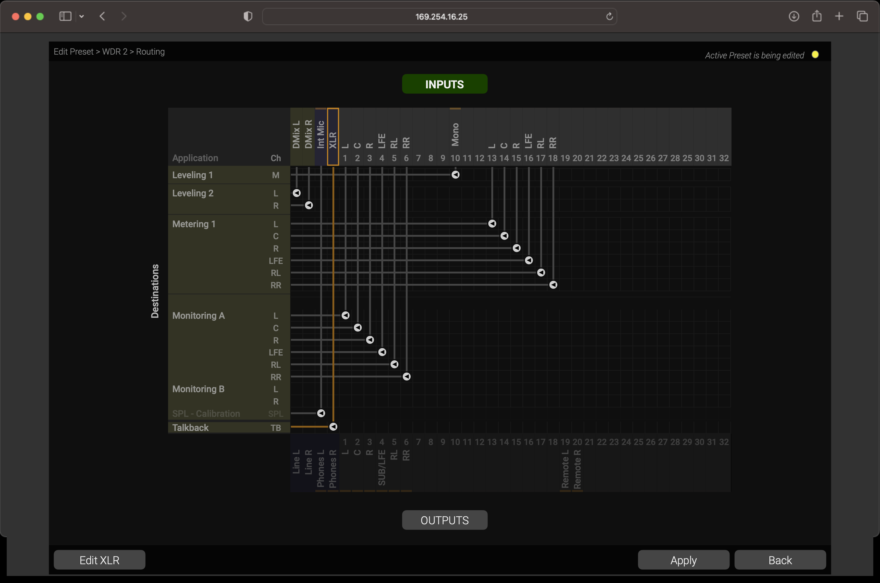
TouchControl 5
Features
Talkback
Talkback
  Built-in
  External XLR

Slide 37
TouchControl 5
Features
InterCOM
Users of multiple TouchControl 5’s in the network can communicate
Input Control Instrument
Mute, Level

Slide 38
TouchControl 5
Features
Faders, faders, faders
Level Control
Fader with PPM, True-peak and phase
Control multiple groups of channels
Relative Levels with knob control

Slide 39
Compact Line
Licenses for Compact Line
Unlock More Features
Surround and Immersive Instruments
  Unlocks advanced metering instruments for surround and immersive formats.
Network Display
  Enables external display in any standard web browser.
External Logging & Integration
  Unlocks advanced integration and external logging capabilities

Slide 40
Title
Users
Who makes use of the Compact Line?

Slide 41
Compact Line
Who?
Customers
Broadcast: Control Room
5.1 Control
5.1 + Stereo + Stereo + Stereo

Slide 42
Compact Line
Who?
Customers
Radio Station
Levels & Loudness
  Studio
  Control
  News
  Weather

Slide 43
Compact Line
Who?
Customers
TV2
  National Broadcaster
  8 Regional Stations
30 x TouchControl 5 (Main Facility)
Application:
  Live Production
  Control Room Stations

Slide 44
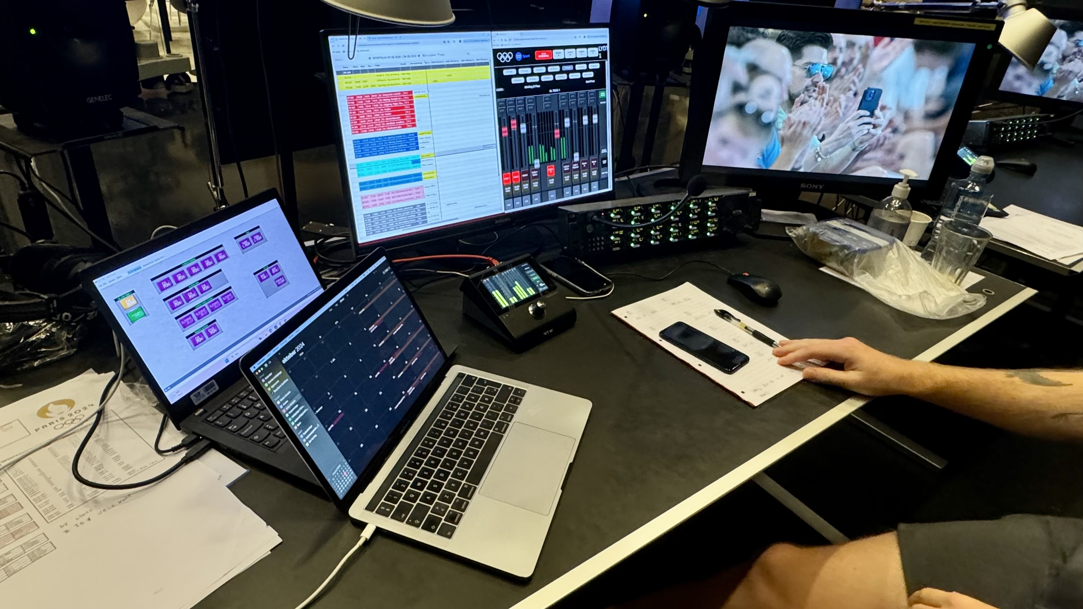
Compact Line
Customer
TV2

Slide 45
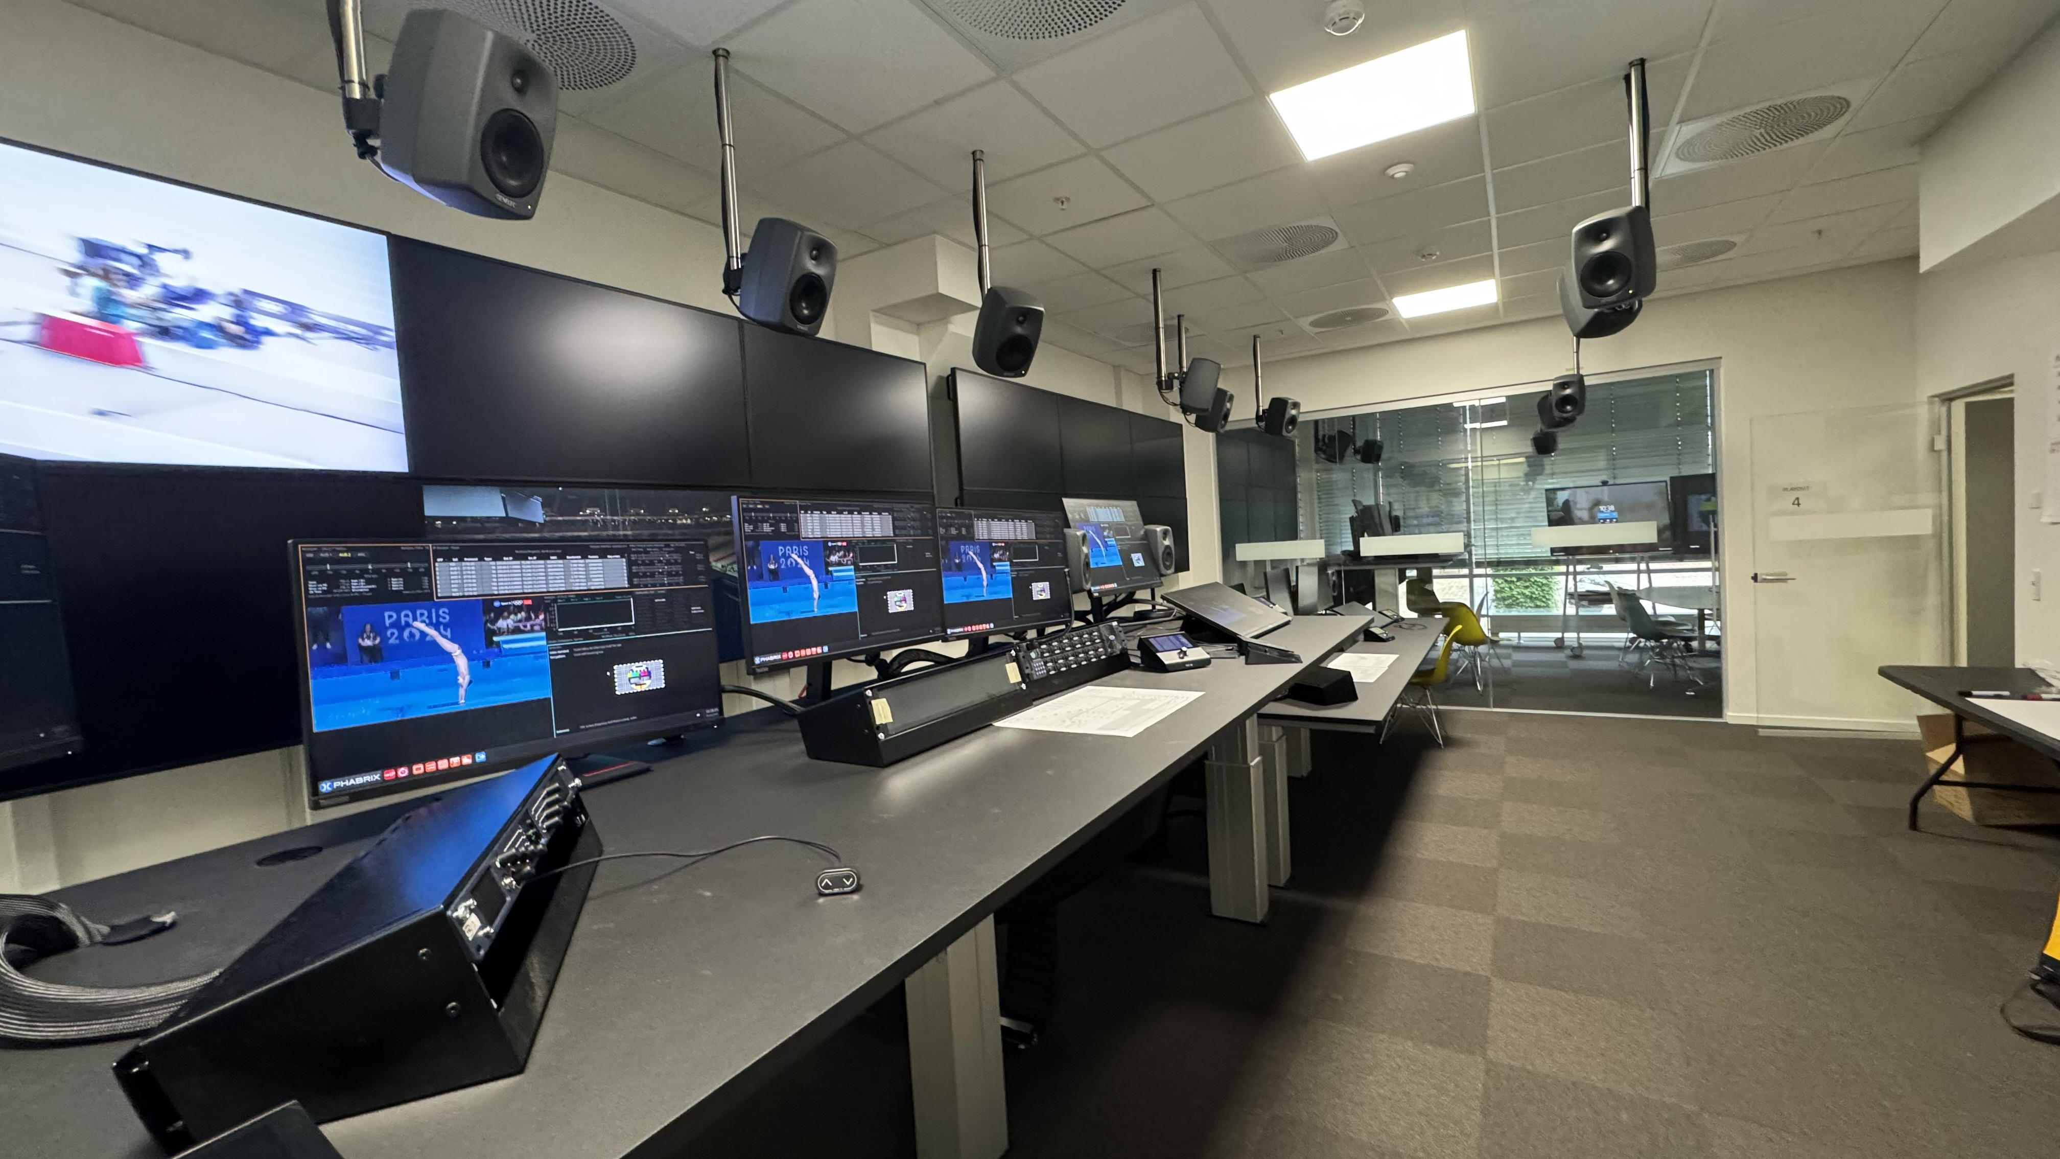
Compact Line
Customer
TV2

Slide 46

More information
rtw.com

